Slide 1

ONLINE BOOK STORE

Slide 2

INTRODUCTION
Online book store is an online web application where a customer can purchase book online though a web browser. The main aim of this project is to create a website where a customer can store books and make edit in that .

Slide 3

EXISTING SYSTEM
E-books continue to gain popularity due to their lower costs and the convenience they offer.
The industry is robust and growing, driven by the increasing penetration of mobile devices and the convenience of online shopping.

Slide 4

PROPOSED SYSTEM
Upload: Admins and authors can upload new books via a form that includes fields for metadata and file uploads.
Edit: Admins and authors can edit book details through the admin dashboard.
Include a delete button for each book entry in the list which is not available.

Slide 5

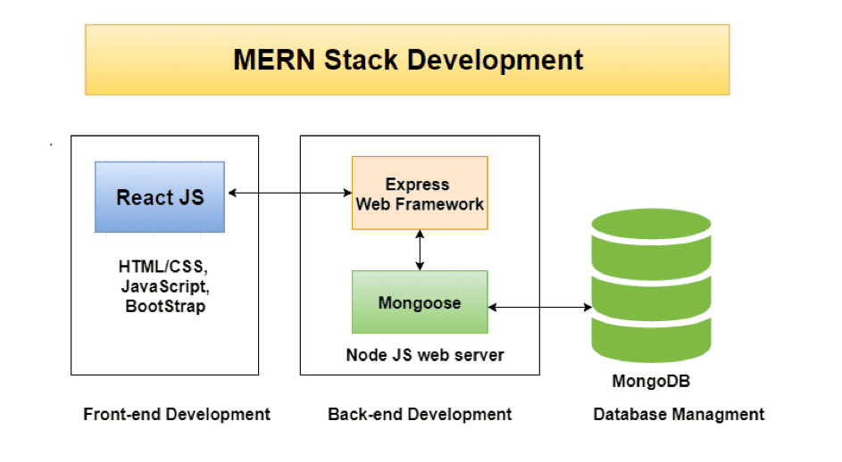
SOFTWARE REQUIREMENT

Slide 6
View Module
Add product
In add product you can add books .
It store in the book module. And there are different kind of books available .
Books
About us

Slide 7

Add Module
1.User : Enable admin to create book availability manage their details, view cost, and description.
2.Allow admin to add book if book is available in the market.
3.User can also update the book if any changes in description or price.
4.Number of books can be added in the store and if book is not available we can delete it from the store.

Slide 8

Data store Module
Utilizes robust databases like MySQL, or NoSQL options to store user data, book details, and inventory records.
Implements regular data backups and provides mechanisms for data recovery in case of failures.

Slide 9

Customer Module
1. Customer Satisfaction Score (CSAT): Measure customer satisfaction through surveys.
2. Net Promoter Score (NPS): Gauge customer loyalty by asking how likely they are to recommend your store.
3. Average Response Time: Track the average time taken to respond to customer inquiries.
4. Resolution Time: Monitor the time taken to resolve customer issues

Slide 10
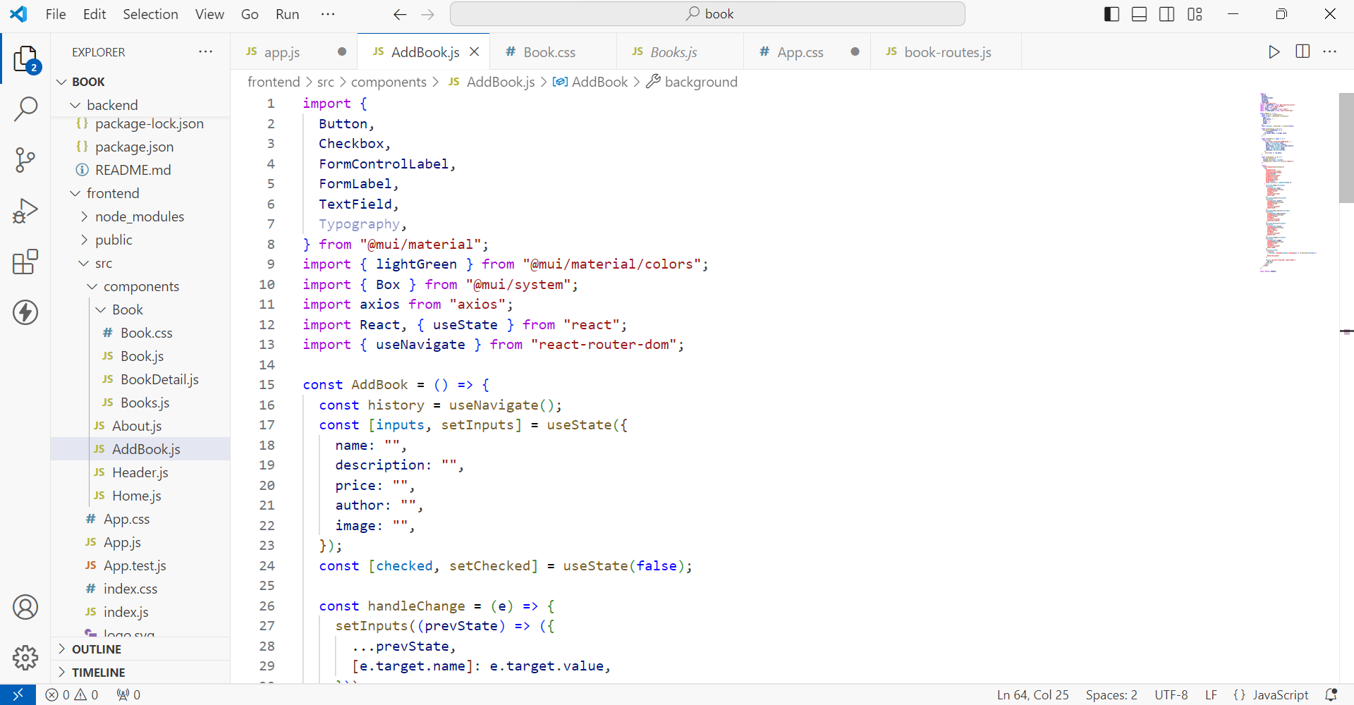
FRONTEND SOURCE CODE

Slide 11
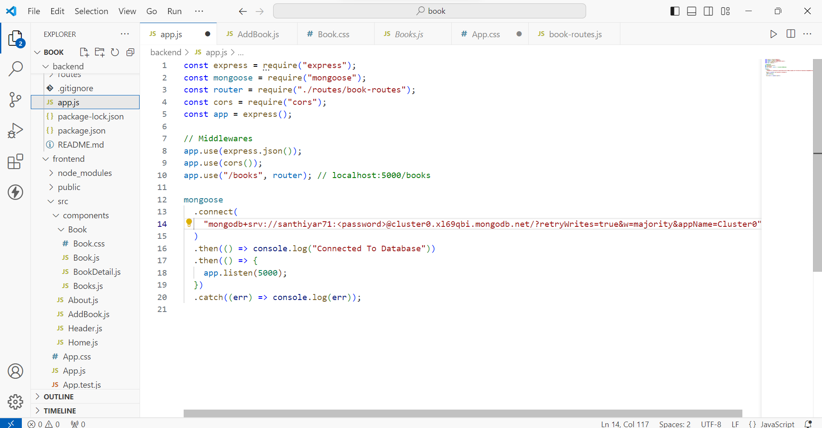
BACKEND SOURCE CODE

Slide 12
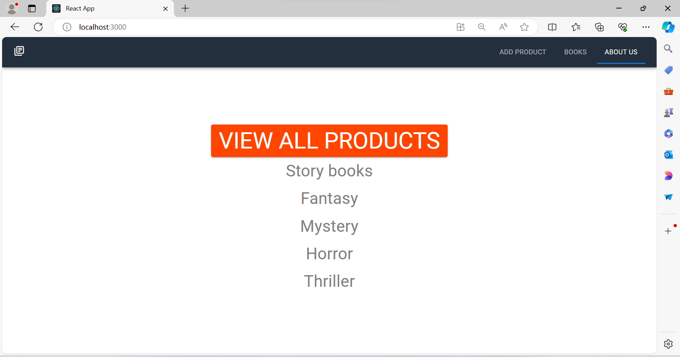
FRONTEND OUTPUT

Slide 13
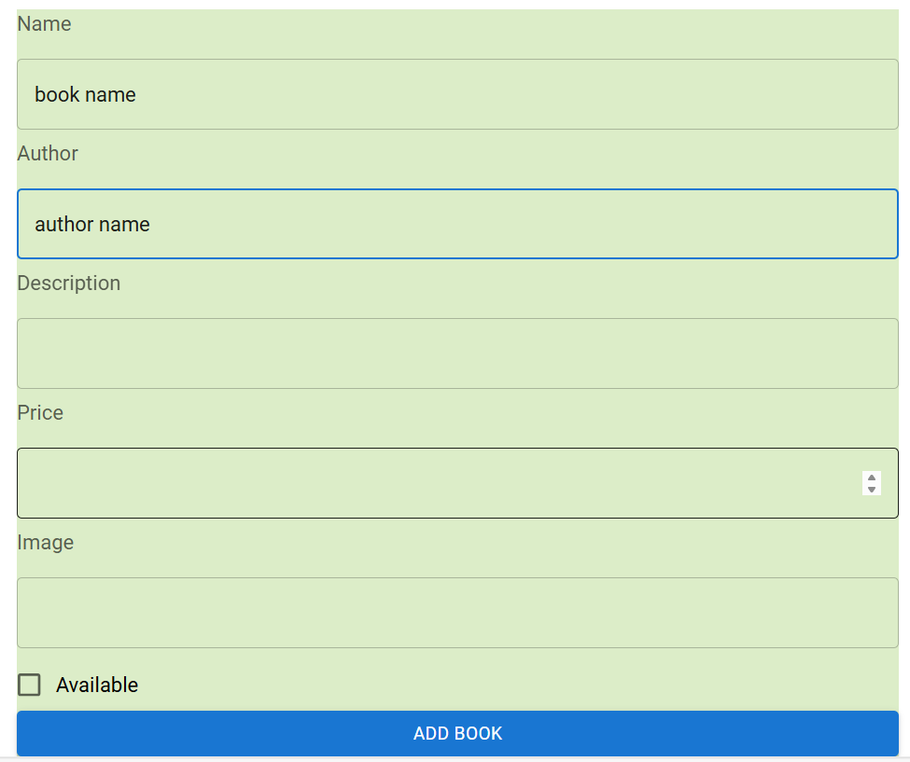
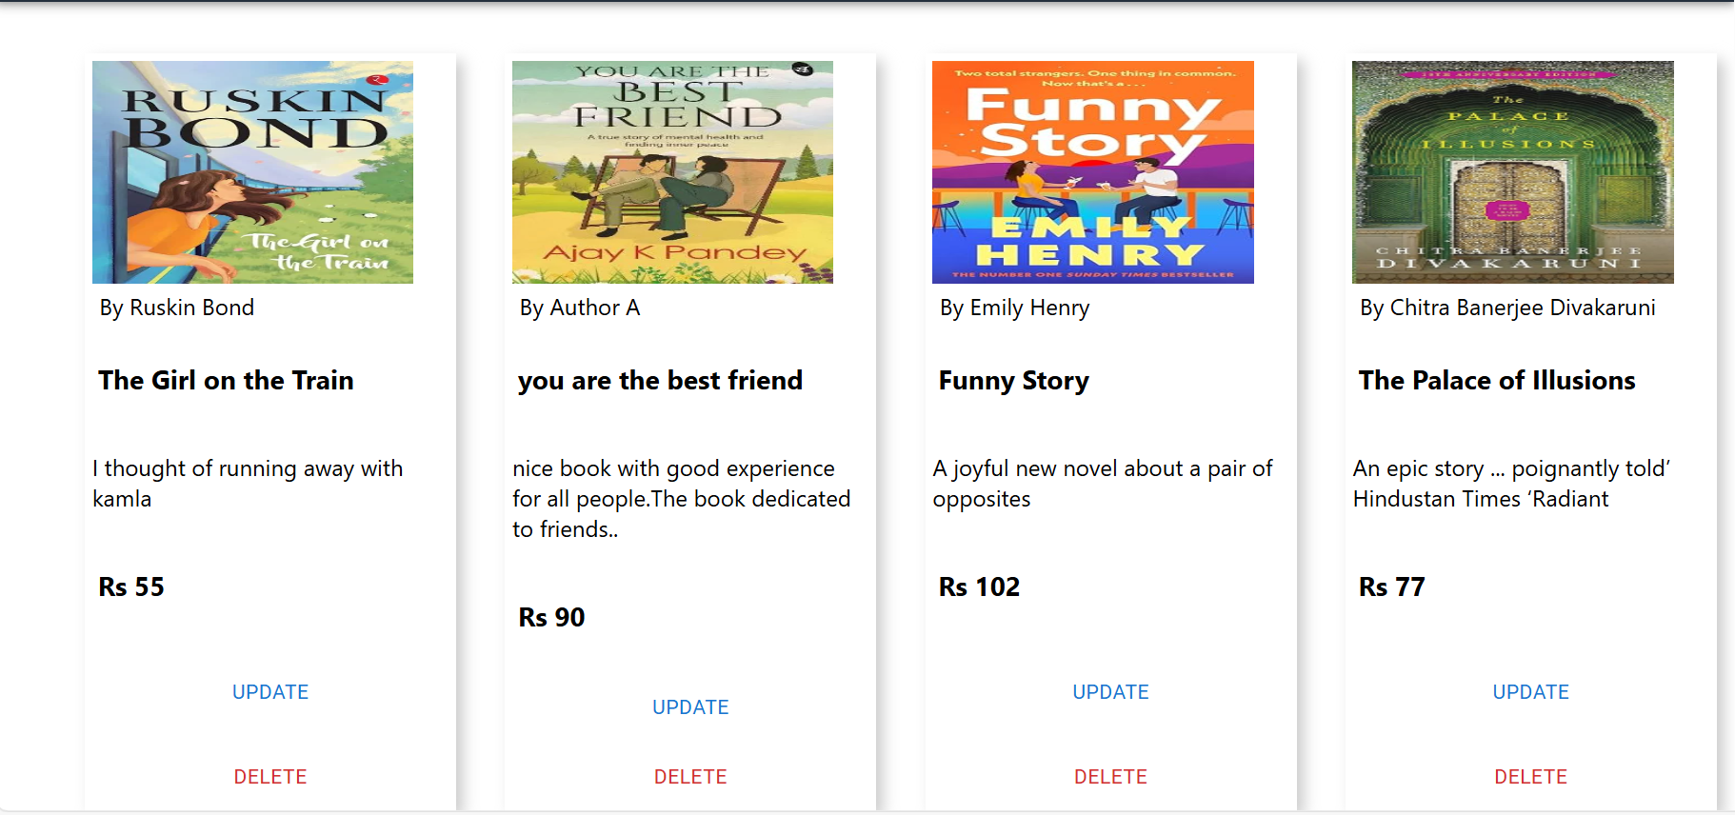
FRONTEND OUTPUT

Slide 14
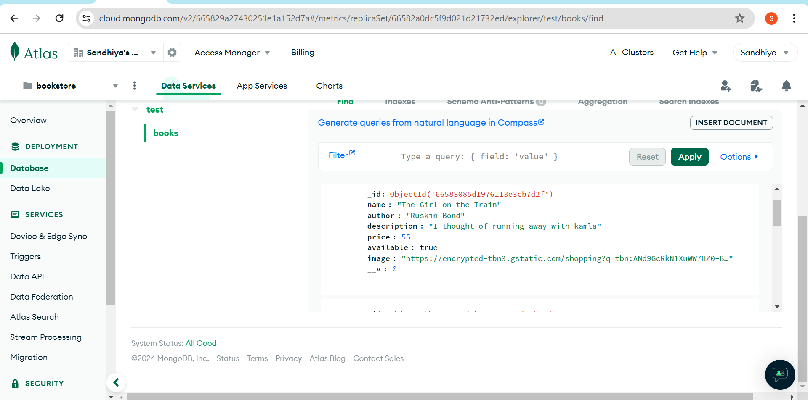
BACKEND OUTPUT

Slide 15

Project Overview:
The primary objective is to create a user-friendly, efficient, and scalable online platform for purchasing books.
The platform aims to offer a wide variety of books, cater to different customer preferences, and provide a seamless shopping experience.
Thus the online book store aims to create a robust and user-centric platform that meets the needs of book enthusiasts and drives business growth.

Slide 16

FUTURE GOAL
Outline future plans for the online bookstore project, including expansion strategies, improvements to the platform, upcoming marketing initiatives, and goals for growth.
Additionally, the expansion of e-books and audiobooks will likely continue to shape the industry. Overall, online bookstores have a bright future ahead, fueled by evolving consumer preferences and digital innovations.

Slide 17

CONCLUSION
In conclusion, the growing trend of online shopping and the convenience it offers, coupled with the timeless appeal of literature, there is a significant market opportunity. As society continues to embrace digitalization, an online bookstore targeting men holds considerable potential for success in the evolving landscape of the literary market.

Slide 18


